Slide 1
Building Secure Solutions in Azure

Slide 2
Common questions customers ask
Can the cloud be more secure than on premises?
What technical and operation safeguards are in place?
Where is my data and who can access it?
What can I do to ensure the security of my cloud deployments?
How do I meet my compliance obligations?
Notes:
Slide title: Common questions customer asking
Slide objectives: Provide an overview of customer questions in terms of security
High level details: But this has raised the many open and eye opening questions about securing an organization assets and customer asking questions about ….
Additional details: http://download.microsoft.com/download/0/1/F/01FD0D63-956E-44EF-BDCB-A66088E8265F/Top-10%20Questions%20to%20Ask%20Your%20Cloud%20Provider.pdf

Slide 3
Agenda
Azure Platform Security Features
Data Security, Control and Access
Understand Microsoft Azure Privacy, Control, Transparency and Compliance
Notes:
Microsoft Azure infrastructure includes hardware, software, administrative and operations staff, and physical data centers.
Security
Microsoft has decades-long experience building enterprise software and running some of the largest online services in the world. It has leveraged this to implement and continuously improve security-aware software development, operational management, and threat mitigation practices that are essential to the strong protection of data in the cloud. Security is built into Azure from the ground up, starting with the Secure Development Lifecycle, a mandatory development process that embeds security requirements into every phase of the development process.
Privacy and Control
Customers will only user services they trust. For over 20 years, Microsoft has been a leader in creating robust online solutions designed to protect the privacy of our customers. Today, Microsoft cloud infrastructure supports over a billion customers around the globe. Azure itself has more than 240 million user accounts, in companies and organizations in 127 countries, that entrust their mission-critical data to Microsoft. The Microsoft Online Services Privacy Statement, describes the specific privacy policy and practices covering our customer’s data in Azure.
Control
For many organizations, the benefits of moving to the cloud are clear. Still, fear of losing control causes their decision makers to hesitate. Where will data be stored? Who owns the organization’s data? Who will be accessing the data? And what happens if the organization wants to switch providers? These are all valid questions—questions Microsoft has in mind when making a clear commitment to provide customers with control over their data. This commitment is unique among major cloud service providers.
Compliance
Microsoft invests heavily in the development of robust and innovative compliance processes. The Microsoft compliance framework for online services maps controls to multiple regulatory standards. This enables Microsoft to design and build services using a common set of controls, streamlining compliance across a range of regulations today and as they evolve in the future.
Microsoft compliance processes also make it easier for customers to achieve compliance across multiple services and meet their changing needs efficiently. Together, security-enhanced technology and effective compliance processes enable Microsoft to maintain and expand a rich set of third-party certifications. These help customers demonstrate compliance readiness to customers, auditors, and regulators. As part of its commitment to transparency, Microsoft shares third-party verification results with its customers.

Slide 4
Cloud Services – Shared Responsibility
On Premises
Infrastructure
(as a Service)
Platform
(as a Service)
Software
(as a Service)
Applications
Applications
Applications
Applications
Data
Data
Data
Data
Runtime
Runtime
Runtime
Runtime
Managed by:
Middleware
Middleware
Middleware
Middleware
O/S
O/S
O/S
O/S
Customer
Virtualization
Virtualization
Virtualization
Virtualization
Vendor
Servers
Servers
Servers
Servers
Storage
Storage
Storage
Storage
Networking
Networking
Networking
Networking
Notes:
Shared Responsibility A Key To Effective Cloud Security. The cloud service provider is responsible for the security of the infrastructure and the customer of the cloud service provider is responsible for security of the application or service running on top of the infrastructure.

Slide 5
Azure Platform Security Features

Slide 6
Security at the core
Security Development Lifecycle (SDL)
www.microsoft.com/sdl
Assume breach simulation
Global 24x7 Incident response
Notes:
SDL (Designing for security from the ground up). Microsoft Azure development adheres to the Security Development Lifecycle (SDL). The SDL became central to Microsoft’s development practices a decade ago and is shared freely with the industry and customers. It embeds security requirements into systems and software through the planning, design, development, and deployment phases.
Assume breach (Hardening cloud services). One key operational best practice that Microsoft uses to harden its cloud services is known as the “assume breach” strategy. A dedicated “red team” of software security experts simulates real-world attacks at the network, platform, and application layers, testing Microsoft Azure’s ability to detect, protect against, and recover from breaches. By constantly challenging the security capabilities of the service, Microsoft can stay ahead of emerging threats.
Incident response (mitigating the effects of attacks). Microsoft Azure has a global, 24x7 incident response service that works to mitigate the effects of attacks and malicious activity. The incident response team follows established procedures for incident management, communication, and recovery, and uses discoverable and predictable interfaces internally and to customers.

Slide 7
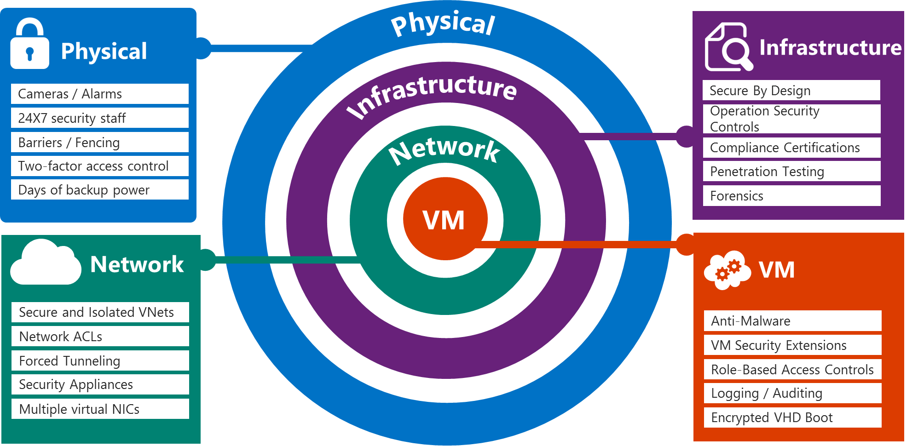
Security (Architecture? Defense in depth?)
Notes:
Physical Infrastructure Slide script:
Azure infrastructure includes hardware, software, administrative and operations staff, and physical data centers. Windows Azure addresses security risks across its infrastructure with continuous intrusion detection and prevention systems, denial of service attack prevention, regular penetration testing, and forensic tools that help identify and mitigate threats. With this level of protection, Azure, customers can reduce the need to invest in these capabilities on their own and benefit from economies of scale in Microsoft datacenter infrastructure.
24-hour monitored physical security. Microsoft datacenters are physically constructed, managed, and monitored 24 hours a day to shelter data and services from unauthorized access as well as environmental threats.
Monitoring and logging. Centralized monitoring, correlation, and analysis systems manage the large amount of information generated by devices within the Azure environment, providing continuous visibility and timely alerts to the teams that manage the service. Additional monitoring, logging, and reporting capabilities provide visibility to customers.
Software update management. Security patches help protect systems from known vulnerabilities. Integrated deployment systems manage the distribution and installation of security updates for Microsoft software. Customers can apply similar update management processes for virtual machines (VMs) deployed on Azure.
Anti-Virus/Anti-Malware protection. Azure software components must go through a virus scan prior to deployment. Code is not moved to production without a clean and successful virus scan. Microsoft recommends that customers run some form of anti-malware or anti-virus on all virtual machines (VMs). Customers can install Microsoft Endpoint Protection or another antivirus solution on VMs, and VMs can be routinely reimaged to clean out intrusions that may have gone undetected.
Intrusion /DDoS Defense. Azure has a defense system against Distributed Denial-of-Service (DDoS) attacks on Azure platform services. It uses standard detection and mitigation techniques. Azure’s DDoS defense system is designed to withstand attacks generated from outside and inside the platform.
Penetration testing. Microsoft conducts regular penetration testing to improve Windows Azure security controls and processes. Customers can carry out authorized penetration testing on their applications hosted in Windows Azure.
Network Slide script:
Azure networking provides the infrastructure necessary to securely connect VMs to one another and to connect on-premises data centers with Azure VMs. Azure blocks unauthorized traffic to and within Microsoft data centers using a variety of technologies such as firewalls, NATs, partitioned Local Area Networks and physical separation of back-end servers from public-facing interfaces.
Network isolation. In Azure, a customer subscription can include multiple deployments, and each deployment can contain multiple tenants, or virtual machines (VMs). Network isolation prevents unwanted tenant-to-tenant communications, and access controls block unauthorized users from the network. Virtual machines do not receive inbound traffic from the Internet unless customers configure them specifically to do so. The overarching principle within Azure is to allow only connections and communications that are necessary for cloud services to operate, blocking all other ports and connections by default.
Virtual Networks. A customer can choose to assign multiple deployments within a subscription to a virtual network and allow those deployments to communicate with each other through private IP addresses. Each virtual network is isolated from other virtual networks.
VPN and ExpressRoute. Microsoft enables connection from customer sites and remote workers to Azure Virtual Networks using Site-to-Site and Point-to-Site VPNs. For even better performance, customers can use an optional Express Route, a private fiber link into Azure data centers that keeps their traffic off the Internet.

Slide 8
Data security, control and access
Notes:
Slide title: Data control and access
Slide objectives: Provide an overview of Microsoft Azure privacy and control.
Slide script:
Customers will only use cloud solution providers in which they have great trust. They must trust that the privacy of their information will be protected, and that their data will be used in a way that is consistent with their expectations.
We build privacy protections into Azure through Privacy by Design, a program which describes how we build and operate products and services to protect privacy. Standards and processes that support Privacy by Design principles include the Microsoft Online Services Privacy Statement (which details Microsoft’s core privacy requirements and practices) and the Microsoft Secure Development Lifecycle (which includes addressing privacy requirements).

Slide 9

Secrets should not be in source control
http://bit.ly/1NJsckY
Notes:
Speaker Notes: talk about unfortunate case where heeding this simple advice could have saved this guy $6,500 (How a bug in Visual Studio 2015 exposed my source code on GitHub and cost me $6,500 in a few hours)

Slide 10
Deploying secrets to Azure Web Apps
Notes:
Demo script: 0_Demo_Deploying secrets to Azure.docx
Code: 0_Demo_SecureSecrets (VS2015)

Slide 11
Data security
Data segregation
Data protection At-rest and In-transit
Encryption
Data redundancy
Data destruction
Notes:
Slide title: Data security
Slide objectives: Provide an overview of Azure data protection.
Slide script:
Azure provides customers with strong data security – both by default and as customer options.
Technological safeguards, such as encrypted communications, and operation processes help keep Customer Data secure. Customers have the flexibility to implement additional encryption and manage their own keys.
Data segregation/isolation. Azure is a multi-tenant service, meaning that multiple customers’ deployments and virtual machines are stored on the same physical hardware. Azure uses logical isolation to segregate each customer’s data from that of others. This provides the scale and economic benefits of multitenant services while rigorously preventing customers from accessing one another’s data.
Data at rest. Customers are responsible for ensuring that data stored in Azure is encrypted in accordance with their standards. Azure offers a wide range of encryption capabilities, giving customers the flexibility to choose the solution that best meets their needs.
Data in transit. For data in transit, customers can enable encryption for traffic between their own VMs and end users. Azure protects data in transit to or from outside components, as well as data in transit internally, such as between two virtual networks. Azure uses industry standard transport protocols such as TLS between user devices and Microsoft datacenters, and within datacenters themselves.
Encryption management. Encryption of data in storage and in transit can be used by Azure customers align with best practices for ensuring confidentiality and integrity of data. It is straightforward for customers to configure their Azure cloud services to use SSL to protect communications from the Internet and even between their Azure hosted VMs.
Data redundancy. Microsoft ensures data is protected in the event of a cyberattack or physical damage to a datacenter. Customers may opt for in-country storage for compliance or latency considerations or out-of-country storage for security or disaster recovery purposes. Data may be replicated within a selected geographic area for redundancy, but will not be transmitted outside it.
Data destruction. When customers delete data or leave Azure, Microsoft follows strict standards for overwriting storage resources before reuse, as well physical destruction of decommissioned hardware. Microsoft executes a complete deletion of data on customer request and on contract termination.

Slide 12
Data Control
Data location - Customers can specify the geographic areas where their customer data is stored
Data access - Access to customer data by Microsoft personnel is restricted; Microsoft provides cloud-service-specific privacy statements and strong contractual commitments to safeguard Customer Data
Data protection - Technical safeguards help keep Customer Data secure; Customers have the flexibility to implement additional encryption and manage their own keys
Access controls are verified by independent audit and certifications
12
Notes:
Data location: Customers can specify the geographic areas where their customer data is stored. Microsoft will not transfer data outside where the customer specifies, except where necessary to provide support, troubleshoot, or comply with local legal requirements.
Data access: Access to customer data by Microsoft personnel is restricted, and granted only when necessary for support, then revoked when no longer needed. Customers can also view access and usage reports.
Data protection: Technical safeguards help keep Customer Data secure; Azure gives customers the flexibility to implement additional encryption and manage their own keys. Microsoft Azure Key Vault offers an easy, cost-effective way to safeguard keys and other secrets in the cloud using Hardware Security Modules (HSMs).
Additional details:
Data location Slide script: Explain how Microsoft Azure makes multiple copies of your data in each location – so even if you have your data in one location, you still have 3 different copies.
Control over data location. For many customers, knowing and controlling the location of their data can be an important element of data privacy compliance and governance. Microsoft Azure customers can specify the geographic areas where their customer data is stored. Data may be replicated within a geographic area for redundancy, but will not be transmitted outside it. When customers delete data or leave Microsoft Azure, Microsoft follows strict standards for overwriting storage resources before reuse, as well physically destruction of decommissioned hardware. Microsoft Azure replicates data both locally and to different physical locations.
To guard against hardware failures and improve availability, every blob is replicated across three computers in a Microsoft Azure datacenter.
To ensure more robust backup, Windows offers geo-replicated storage
Microsoft may transfer Customer Data within a geo (e.g., within Europe) for data redundancy or other purposes. For example, Azure replicates Blob and Table data between two regions within the same geo for enhanced data durability in case of a major data center disaster. Microsoft will not transfer Customer Data outside the geo(s) customer specifies (for example, from Europe to U.S. or from U.S. to Asia) except where necessary for Microsoft to provide customer support, troubleshoot the service, or comply with legal requirements; or where customer configures the account to enable such transfer of Customer Data.
When customers entrust their data to Microsoft, they are not giving up control. For many customers, knowing and controlling the location of their data can be an important element of data privacy, compliance, and governance. Microsoft Azure offers an ever-expanding network of data centers across the globe. Most Azure services permit customers to specify the particular geography where their customer data will be stored. Data may be replicated within a selected geographic area for redundancy, but will not be transmitted outside it.
Data Access Slide script: Role-Based Access Control. Azure role-based access control enables customers to grant appropriate access to Azure AD users, groups, and services, by assigning roles to them on a subscription or resource group or individual resource level. The assigned role defines the level of access that the users, groups, or services have on the Azure resource.
Restricted data access and use. Access to customer data by Microsoft personnel is restricted. Customer Data is only accessed when necessary to support the customer’s use of Microsoft Azure. This may include troubleshooting aimed at preventing, detecting or repairing problems affecting the operation of Microsoft Azure and the improvement of features that involve the detection of, and protection against, emerging and evolving threats to the user (such as malware or spam). When granted, access is carefully controlled and logged. Strong authentication, including the use of multi-factor authentication, helps limit access to authorized personnel only. Access is revoked as soon as it is no longer needed.
Microsoft employee access management. Access to customer data by Microsoft personnel is restricted. Customer data is only accessed when necessary to support the customer’s use of Azure. This may include troubleshooting aimed at preventing, detecting, or repairing problems affecting the operation of Azure and the improvement of features that involve the detection of, and protection against, emerging and evolving threats to the user (such as malware or spam).
Contractual commitments. Microsoft is unique among major cloud service providers in providing cloud-service-specific privacy statements and making strong contractual commitments to safeguard customer data and protect privacy. Microsoft makes the standard contractual clauses created by the European Union (known as the “EU Model Clauses”) available to enterprise customers to provide additional contractual guarantees concerning transfers of personal data. Recently, Brad Smith announced that Microsoft’s cloud contracts have been validated by European Union data protection authorities as meeting the rigorous privacy standards that regulate companies operating in E.U. member states.
Restricted data access slide script:
Restricted access by Microsoft personnel. Access to customer data by Microsoft personnel is restricted. Customer data is only accessed when necessary to support the customer’s use of Azure. This may include troubleshooting aimed at preventing, detecting, or repairing problems affecting the operation of Azure and the improvement of features that involve the detection of, and protection against, emerging and evolving threats to the user (such as malware or spam). When granted, access is controlled and logged. Strong authentication, including the use of multi-factor authentication, helps limit access to authorized personnel only. Access is revoked as soon as it is no longer needed.
Strong Authentication. Microsoft Azure provides Multi-Factor Authentication (MFA) that delivers strong authentication via a range of easy verification options—phone call, text message, or mobile app notification—enabling users to choose the method they prefer.
Contractual commitments. Microsoft is unique among major cloud service providers in providing cloud-service-specific privacy statements and making strong contractual commitments to safeguard customer data and protect privacy. Microsoft makes the standard contractual clauses created by the European Union (known as the “EU Model Clauses”) available to enterprise customers to provide additional contractual guarantees concerning transfers of personal data.
ISO/IEC 27018 certification. Microsoft Azure services have incorporated the controls that embody ISO/IEC 27018, including a prohibition on the use of customer data for advertising and marketing purposes without the customer’s express consent. Microsoft will not use customer data for purposes unrelated to providing the cloud service.
Restricted data access and use. Access to customer data by Microsoft personnel is restricted. Customer Data is only accessed when necessary to support the customer’s use of Windows Azure. This may include troubleshooting aimed at preventing, detecting or repairing problems affecting the operation of Windows Azure and the improvement of features that involve the detection of, and protection against, emerging and evolving threats to the user (such as malware or spam). When granted, access is carefully controlled and logged. Strong authentication, including the use of multi-factor authentication, helps limit access to authorized personnel only. Access is revoked as soon as it is no longer needed. Azure does NOT share Customer Data with its advertiser-supported services, nor is customer data mined for advertising.
Notification of lawful requests for information. Microsoft does not disclose customer data to law enforcement unless required by law, and will notify customers when compelled to disclose. The Law Enforcement Request Report discloses details of requests every 6 months.
Transparency and simplicity of data use policies. Microsoft keeps customers informed about the processes to protect data privacy and security, including practices and policies. Microsoft also provides the summaries of independent audits of services, which help customers pursue their own compliance.

Slide 13
Data encryption
Layer | Encryption Support
Application | .Net encryption API
 | Client side encryption with Azure Key Vault for Storage
 | SQL TDE/CLE on SQL server on Azure IaaS servers
Platform | SQL Azure Transparent Data Encryption (TDE), Dynamic Data Masking, Row-level security (RLS), Auditing & Threat Detection
 | StorSimple –A 256-bit Advanced Encryption Standard (AES) algorithm for encrypting data as it moves to and from the cloud
 | Azure Key Vault - Hardware Security Modules (HSMs)
System | BitLocker
 | Azure Disk Encryption for Windows and Linux IaaS VMs
 | Partner solutions for system volume encryption
Notes:
Slide title: Data encryption
Slide objective: Explain data encryption layers available with Microsoft Azure.
Slide script:
Application layer
.NET: The .NET Framework provides implementations of many standard cryptographic algorithms. These algorithms are easy to use and have the safest possible default properties. In addition, the .NET Framework cryptography model of object inheritance, stream design, and configuration is extremely extensible.
SQL TDE/CLE: Transparent data encryption (TDE) is designed to provide protection for the entire database at rest without affecting existing applications. Implementing encryption in a database traditionally involves complicated application changes such as modifying table schemas, removing functionality, and significant performance degradations. Microsoft SQL Server offers two levels of encryption: database-level and cell-level. Both use the key management hierarchy.
Platform Layer
SQL Azure: SQL Azure Transparent Data Encryption (TDE), Dynamic Data Masking, Row-level security (RLS), Auditing & Threat Detection
StorSimple: Instead of tape backup or remote replication, StorSimple arrays protect data automatically with cloud snapshots. Cloud snapshots are similar to local snapshots in other products, but are stored remotely in cloud storage where they can be quickly accessed online without the lengthy delays normally incurred with off-site storage.
Key Vault: Secure key management is essential to protecting data in the cloud. With Key Vault, you can encrypt keys and small secrets like passwords with keys stored Hardware Security Modules (HSMs). For added assurance, import or generate your keys in HSMs certified to FIPS 140-2 level 2 standards – so that your keys stay within the HSM boundary. Key Vault is designed so that Microsoft does not see or extract your keys.
System Layer
BitLocker: BitLocker Drive Encryption allows you to encrypt all data stored on the Windows operating system volume and configured data volumes. A Trusted Platform Module (TPM) is a microchip that is built into a computer. It is used to store cryptographic information, such as encryption keys. Information stored on the TPM can be more secure from external software attacks and physical theft. BitLocker uses the TPM to help protect the Windows operating system and user data and helps to ensure that a computer is not tampered with, even if it is left unattended, lost, or stolen.
Azure Disk Encryption for VM: Azure Disk Encryption is a new capability that lets you encrypt your Windows and Linux IaaS virtual machine disks. Azure Disk Encryption leverages the industry standard BitLocker feature of Windows and the DM-Crypt feature of Linux to provide volume encryption for the OS and the data disks. The solution is integrated with Azure Key Vault to help you control and manage the disk encryption keys and secrets in your key vault subscription, while ensuring that all data in the virtual machine disks are encrypted at rest in your Azure storage.
URL: https://azure.microsoft.com/en-us/documentation/articles/azure-security-disk-encryption/

Slide 14
Azure Key Vault
Key Vault offers encryption key management in the cloud, enabling customers to safeguard keys for use in applications
Create/import, store, and manage cryptographic keys
Secure keys in Hardware Security Modules (HSMs)
Maintain control over keys - grant and revoke use by applications as needed
14
Notes:
Slide title: Key Vault service
Slide objective: Explain what Key Vault service is and how it works.
Slide script:
Secure key management is essential to protecting data in the cloud. With Key Vault, you can encrypt keys and small secrets like passwords with keys stored Hardware Security Modules (HSMs). For added assurance, import or generate your keys in HSMs certified to FIPS 140-2 level 2 standards – so that your keys stay within the HSM boundary. Key Vault is designed so that Microsoft does not see or extract your keys.
There is no need to provision, configure, patch, and maintain Hardware Security Modules (HSMs) and key management software. You can provision new vaults and keys (or import keys from your own HSMs) in minutes and centrally manage keys, secrets, and policies. You maintain control over your keys – simply grant permission for your own and third party applications to use them as needed. Applications never have direct access to keys. Enable developers to easily manage keys used for dev/test and migrate seamlessly to production keys managed by security operations.
Key Vault also rapidly scales to meet the cryptographic needs of your cloud applications and match peak demand without the cost associated with deploying dedicated HSMs. You can achieve global redundancy by provisioning Vaults in Azure global datacenters – keep a copy in your own HSMs for added durability.
Benefits:
Scale to meet the encryption needs of cloud applications
Improve performance of cloud applications by storing keys in the cloud
Reduce the time and cost required to maintain dedicated HSM hardware
Maintain control over keys - grant and revoke use by applications as needed
Gain visibility into key use through Azure logging

Slide 15
SQL Database V12 Security Enhancements
Notes:
Demo script: 1_Demo_SQLV12_Transparent Data Encryption.docx
Details: Security is a primary concern for anyone who runs their business in the cloud. The latest security features released in V12 include:
Row-level security (RLS)
Dynamic Data Masking
Contained databases
Application roles managed with GRANT, DENY, REVOKE
Transparent Data Encryption (TDE)
Speaker Notes: Demonstrate Transparent Data Encryption (TDE) as part of this demo

Slide 16
Identity and Access
Notes:
Slide title: Identity and access
Slide objectives: Provide an overview of Identity and access solution of Azure
Slide script:
Azure enables customers to control access to their environments, data and applications. Microsoft offers comprehensive and federated identity and access management solutions for customers to use across Azure and other services such as Office 365, helping them simplify the management of multiple environments and control user access across applications.

Slide 17
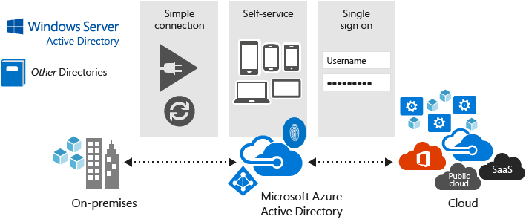
Identity and access control
Enterprise cloud directory
Multi-Factor Authentication (MFA)
Access monitoring and logging
Single sign-on
Integration with customer applications
Notes:
Slide title: Identity & access
Slide objectives: Provide an overview of Azure identity & access control.
Slide script:
Azure enables customers to control access to their environments, data and applications. Microsoft offers comprehensive and federated identity and access management solutions for customers to use across Azure and other services such as Office 365, helping them simplify the management of multiple environments and control user access across applications.
Enterprise cloud directory. Azure Active Directory (AD) is a comprehensive identity and access management solution in the cloud. It combines core directory services, advanced identity governance, security, and application access management. Azure Active Directory makes it easy for developers to build policy-based identity management into their applications. Azure Active Directory Premium includes additional features to meet the advanced identity and access needs of enterprise organizations. Azure Active Directory enables a single identity management capability across on-premises, cloud, and mobile solutions.
Multi-Factor Authentication. Microsoft Azure provides Multi-Factor Authentication (MFA). This helps safeguard access to data and applications and enables regulatory compliance while meeting user demand for a simple sign-in process for both on-premises and cloud applications. It delivers strong authentication via a range of easy verification options—phone call, text message, or mobile app notification—allowing users to choose the method they prefer.
Access monitoring and logging. Security reports are used to monitor access patterns and to proactively identify and mitigate potential threats. Microsoft administrative operations, including system access, are logged to provide an audit trail if unauthorized or accidental changes are made. Customers can turn on additional access monitoring functionality in Azure and use third-party monitoring tools to detect additional threats. Customers can request reports from Microsoft that provide information about user access to their environments.
Single sign-on. End users want a secure and convenient way to access their data and applications. Azure AD, along with a variety of supported third-party apps, streamlines the authentication process for users with corporate credentials by providing a single sign-on option across multiple applications and services.
Integration with customer applications. Application developers can integrate their applications with Azure AD to provide single sign-on functionality for their users. This enables enterprise applications to be hosted in the cloud and to easily authenticate users with corporate credentials. It also enables Software-as-a-Service (SaaS) providers to make authentication easier for users in Azure AD organizations when authenticating to their services.

Slide 18
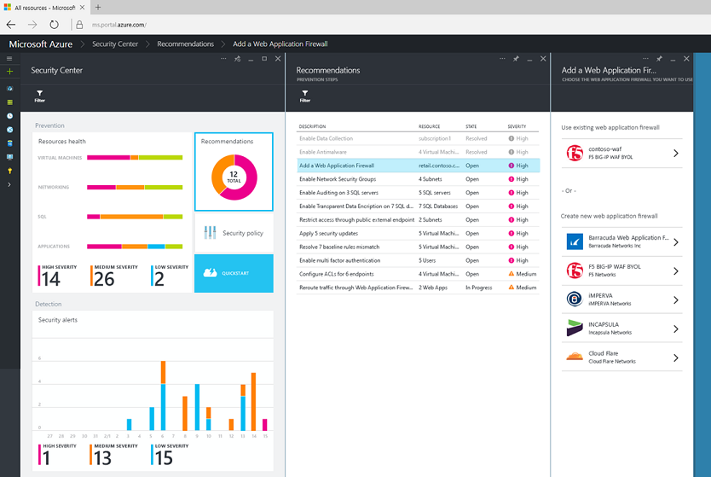
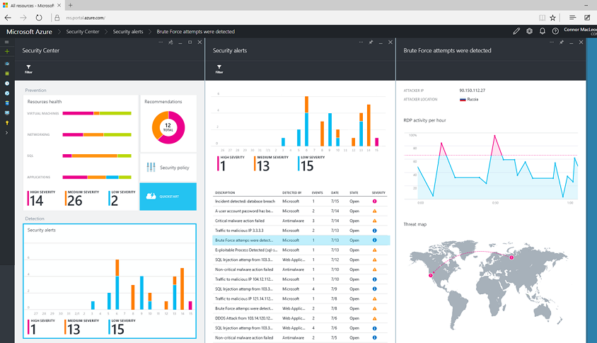
Azure Security Center
Gain visibility and control
Integrated security, monitoring, policy management
Built in threat detections and alerts
Notes:
Azure Security Center provides a unified view of your security state, so your team and/or your organization’s security specialists can get the information they need to evaluate risk across the workloads they run in the cloud. Based on customizable policy, the service can provide recommendations. For example, the policy might be that all web applications should be protected by a web application firewall. If so, the Azure Security Center will automatically detect when web apps you host in Azure don’t have a web application firewall configured, and provide a quick and direct workflow to get a firewall from one of our partners deployed and configured.
Of course, even with the best possible protection in place, attackers will still try to compromise systems. To address this problem and adopt an “assume breach” mindset, the Azure Security Center uses advanced analytics, including machine learning, along with Microsoft’s global threat intelligence network to look for and alert on attacks. Signals are automatically collected from your Azure resources, the network, and integrated security partner solutions and analyzed to identify cyber-attacks that might otherwise go undetected. Should an incident occur, security alerts offer insights into the attack and suggest ways to remediate and recover quickly. Security data and alerts can also be piped to existing Security Information and Events Management (SIEM) systems your organization has already purchased and is using on-premises.
No other cloud vendor provides the depth and breadth of these capabilities, and they are going to enable you to build even more secure applications in the cloud.

Slide 19
Azure Security Center
Notes:
Slide Title : Azure Security Center
Demo script: TBD
Details: TBD

Slide 20
Microsoft Azure Privacy, Control, Transparency and Compliance

Slide 21



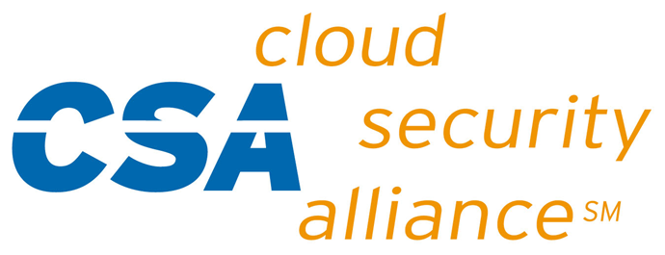





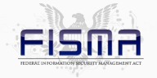

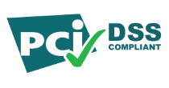

Compliance
CSA Cloud Controls Matrix
HIPAA/ HITECH
AU IRAP Accreditation
Singapore MCTS
Microsoft Azure
SOC 1
SOC 2
UK G-Cloud OFFICIAL
CDSA
CJIS
2010
2011
2012
2013
2014
2015
ISO/IEC 27001:2005
FISMA
ATO
FedRAMP P-ATO
EU Data Protection Directive
PCI DSS Level 1
ISO/IEC 27018
Operations Security Assurance
Notes:
Slide title: Compliance
Slide objectives: Introduce the following section on compliance.
By providing customers with compliant, independently verified cloud services, Microsoft makes it easier for customers to achieve compliance for the infrastructure and applications they run in Azure. Microsoft provides Azure customers with detailed information about our security and compliance programs, including audit reports and compliance packages, to help customers assess our services against their own legal and regulatory requirements.
In addition, Microsoft has developed an extensible compliance framework that enables it to design and build services using a single set of controls to speed up and simplify compliance across a diverse set of regulations and rapidly adapt to changes in the regulatory landscape.

Slide 22
Contractual commitments
Microsoft is the first major cloud provider to adopt the first international code of practice (ISO/IEC 27018) for governing the processing of personal information by cloud service providers
Prohibits use of customer data for advertising and marketing purposes without customer’s express consent
Have European data privacy authorities validate that its enterprise agreement meets EU requirements on international data transfers
Abide by US-EU EU Model Clauses and the US-Swiss Safe Harbor Program
http://bit.ly/1KYyLgu
Notes:
Slide title: Privacy
Slide objectives: Provide an overview of privacy features of Microsoft Azure.
Slide script:
ISO/IEC 27018 certification. Microsoft Azure services have incorporated the controls that embody ISO/IEC 27018, including a prohibition on the use of customer data for advertising and marketing purposes without the customer’s express consent. Microsoft will not use customer data for purposes unrelated to providing the cloud service.
Restricted data access and use. Access to customer data by Microsoft personnel is restricted. Customer Data is only accessed when necessary to support the customer’s use of Windows Azure. This may include troubleshooting aimed at preventing, detecting or repairing problems affecting the operation of Windows Azure and the improvement of features that involve the detection of, and protection against, emerging and evolving threats to the user (such as malware or spam). When granted, access is carefully controlled and logged. Strong authentication, including the use of multi-factor authentication, helps limit access to authorized personnel only. Access is revoked as soon as it is no longer needed. Azure does NOT share Customer Data with its advertiser-supported services, nor is customer data mined for advertising.
Notification of lawful requests for information. Microsoft does not disclose customer data to law enforcement unless required by law, and will notify customers when compelled to disclose. The Law Enforcement Request Report discloses details of requests every 6 months.
Transparency and simplicity of data use policies. Microsoft keeps customers informed about the processes to protect data privacy and security, including practices and policies. Microsoft also provides the summaries of independent audits of services, which help customers pursue their own compliance.
We back our protections with strong contractual commitments to safeguard customer data by abiding by the EU Model Clauses (which governs the processing of personal information), and other international standards. Microsoft uses customer data stored in Azure only to improve service. Azure does not share data with its advertising-supported services or mine customer data for advertising.
Contractual commitments. Microsoft is unique among major cloud service providers in providing cloud-service-specific privacy statements and making strong contractual commitments to safeguard customer data and protect privacy. Microsoft makes the standard contractual clauses created by the European Union (known as the “EU Model Clauses”) available to enterprise customers to provide additional contractual guarantees concerning transfers of personal data.
With regards to recent changes in EU-US Safe Harbor agreements, refer to the EU Model Clause which is a contractual commitment with same safeguards, and the ongoing work in progress of cloud providers working with EU legislatives and US Government to provide compliance with affected parties. The link provides some further information.

Slide 23
Data storage and use
Customers control where Customer Data is stored
Microsoft doesn’t use Customer Data for advertising or mine it for marketing
Microsoft uses Customer Data only to provide the services
Customers may delete Customer Data or leave the service at any time
Notes:
Slide title: Azure Transparency
Slide objectives: Introduce the following section on compliance.
Azure helps enable customer control over Customer Data by providing transparency into where it is stored, who can access it, and how Microsoft helps secure it, with accessible tools and straightforward language
Slide script:
Microsoft Azure is built on the premise that for customers to control their own Customer Data in the cloud, they require visibility into that data. They must know where it is stored. They must also know, through clearly stated and readily available policies and procedures, how we help secure Customer Data, who can access it, and under what circumstances. And don’t take our word for it: Customers can review the third-party audits and certifications that confirm that we meet the standards we set.
Microsoft seeks to give Azure customers control over where their customer data is stored in an ever-expanding network of datacenters around the globe, balanced with the need to store backups at multiple locations in case of a disaster.
Microsoft does not use Azure customer data for advertising—we do not share it with our advertiser-supported services or mine it for marketing. This policy is backed by our enterprise cloud service agreements and reaffirmed by Microsoft’s adoption of the first international code of practice for cloud privacy, ISO/IEC 27018.
We will use customer data only for purposes compatible with providing you the services. In addition to day-to-day operations, Microsoft customer support and operations personnel may access customer data to provide customer support, troubleshoot the service, improve features (such as protection against malware), or comply with legal requirements.
Customers may delete Customer Data or leave the service at any time. In either case, Microsoft follows stringent standards in removing Customer Data from all systems under its control.

Slide 24
Summary
Microsoft’s Azure Platform security features
Data Security, Control and Access
Understand Microsoft Azure Privacy, Control, Transparency and Compliance

Slide 27
Trustworthy foundation
Privacy by Design - Microsoft privacy principles are designed to facilitate the responsible use of customer data, be transparent about practices, and offer meaningful privacy choices
Microsoft Privacy Standard - Guidelines that help ensure privacy is applied in the development and deployment of products and services
Data segregation - Azure uses logical isolation to segregate each customer’s data from that of others
Notes:
Microsoft values customer trust and cares deeply about the privacy and security of their data. We make strong privacy commitments in support of our cloud services and help our customers comply with their own requirements, by addressing robust privacy and security requirements.
Privacy by Design
We have invested heavily over many years to build what we believe is one of the strongest privacy programs in our industry. Our privacy program is founded in Privacy by Design, a principles-based approach to building privacy protections into an organization's practices from the ground up. "Privacy by Design" has become a popular term in the privacy community, but it means different things to different people. At Microsoft, Privacy by Design describes not only how we build products but also how we operate our services and organize ourselves as an accountable technology leader.
Microsoft Privacy Standard
The Microsoft Privacy Standard (MPS) governs privacy aspects of the development and deployment of Microsoft consumer and enterprise products and services. It informs Microsoft employees and vendors about how to develop products and services with users' privacy in mind so that users are able to better understand and control the collection, storage, retention/destruction, and use of their data.
Data Segregation
Azure is a multi-tenant service, meaning that multiple customers’ deployments and virtual machines are stored on the same physical hardware. Azure uses logical isolation to segregate each customer’s data from that of others. This provides the scale and economic benefits of multitenant services while rigorously preventing customers from accessing one another’s data.

Slide 28
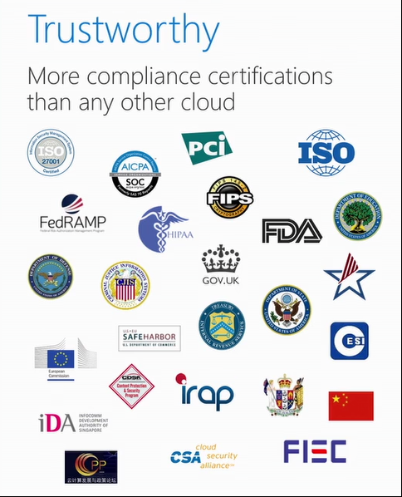
Compliance
Notes:
Slide title: Compliance
Slide objectives: Introduce the following section on compliance.
By providing customers with compliant, independently verified cloud services, Microsoft makes it easier for customers to achieve compliance for the infrastructure and applications they run in Azure. Microsoft provides Azure customers with detailed information about our security and compliance programs, including audit reports and compliance packages, to help customers assess our services against their own legal and regulatory requirements.
In addition, Microsoft has developed an extensible compliance framework that enables it to design and build services using a single set of controls to speed up and simplify compliance across a diverse set of regulations and rapidly adapt to changes in the regulatory landscape.

Slide 29
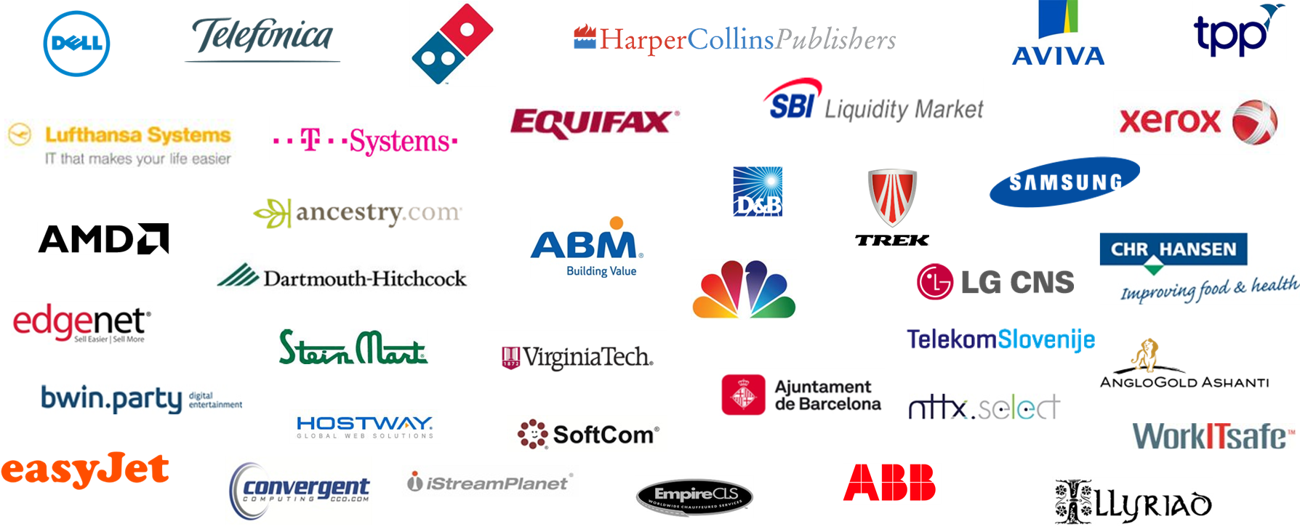
Trusted globally by leading companies
Notes:
Slide title: Trusted globally by leading companies
Slide objectives: Demonstrate customer adoption momentum.
Slide script:
In fact – you saw a number of examples today of enterprises and organizations already benefiting from Azure. There are many, many more – this is a look at a small sampling.
We’re excited to see how each of you will transform IT and your businesses by taking advantage of our investments and solutions that are bringing the Trusted Cloud to life.

